Slide 1
Implementing Waste Management
CGPRT(W) : Ensuring Clean Seas and Coasts in Western Region ……

Slide 2
Objective
To understand the importance of implementing waste management best practices in the field when responding to an oil spill.
CGPRT(W) : Ensuring Clean Seas and Coasts in Western Region ……

Slide 3
Issues
Planning
Types of waste
Temporary/intermediate storage
Transportation
Final disposal
CGPRT(W) : Ensuring Clean Seas and Coasts in Western Region ……

Slide 4
How Much Waste?
For 1,000 m³
25% Evaporated
750 m³
Emulsified (80% water)
3,750 m³
20% Recovered at sea
3,000 m³
750 m³ liquid waste for disposal
Impact the shoreline (mixed with 10x its volume of debris)
30,000 m³ solid waste for disposal
CGPRT(W) : Ensuring Clean Seas and Coasts in Western Region ……

Slide 5
Waste from Crude Oil Spills
Year | Incident name | Oil spilled (tonnes) | Liquid collected (tonnes) | Solid material collected (tonnes) | Total waste collected (tonnes) | Ratio of material collected to spilled oil
1978 | AMOCO CADIZ | 227,000 | 100,000 | 100,000 | 200,000 | 0.9
1989 | EXXON VALDEZ | 37,000 | 97,500 | 38,800 | 136,300 | 3.7
1993 | BRAER | 86,200 | - | 2,000 | 2,000 | 0.02
1995 | SEA PRINCE | 5,500 | 2,000 | 5,100 | 7,100 | 1.3
1996 | SEA EMPRESS | 72,370 | 25,000 | 11,000 | 36,000 | 0.5
2004 | ATHOS 1 | 900 | 200 | 6,700 | 6,900 | 7.7
2007 | HEBEI SPIRIT | 10,900 | 2,610 | 37,620 | 40,230 | 3.7
2010 | DEEPWATER HORIZON | 780,000 | 162,260 | 89,200 | 251,460 | 0.3
Source: ITOPF
CGPRT(W) : Ensuring Clean Seas and Coasts in Western Region ……

Slide 6
Waste from Fuel Oil Spills
Year | Incident name | Oil spilled (tonnes) | Liquid collected (tonnes) | Solid material collected (tonnes) | Total waste collected (tonnes) | Ratio of material collected to spilled oil
1980 | TANIO | 13,500 | - | 28,000 | 28,000 | 2.1
1988 | AMMAZZONE | 2,100 | - | 13,000 | 13,000 | 6.2
1997 | NAKHODKA | 6,200 | - | 50,000 | 50,000 | 8.1
1997 | NISSOS AMORGOS | 3,600 | - | 40,000 | 40,000 | 11.1
1999 | VOLGONEFT 248 | 1,279 | - | 4,500 | 4,500 | 3.5
1999 | ERIKA | 19,800 | 1,100 | 200,000 | 201,100 | 10.2
2001 | BALTIC CARRIER | 2,550 | 965 | 10,750 | 11,715 | 4.6
2002 | PRESTIGE | 63,000 | 50,000 | 159,300 | 209,300 | 3.3
2006 | SOLAR 1 | 2,081 | - | 5,010 | 5,010 | 2.4
2007 | VOLGONEFT 139 | 2,000 | 200 | 79,740 | 79,940 | 40.0
Source: ITOPF
CGPRT(W) : Ensuring Clean Seas and Coasts in Western Region ……

Slide 7
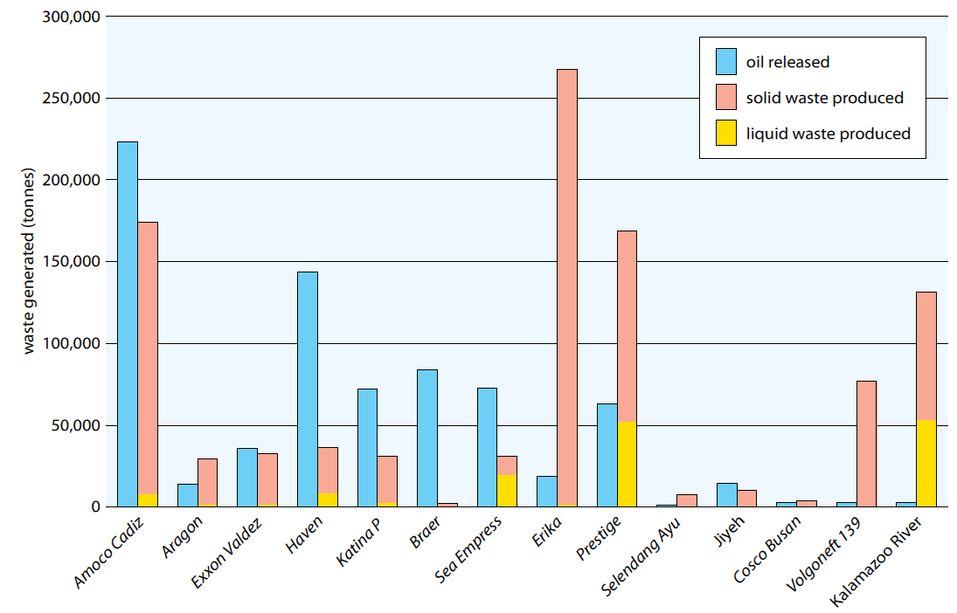
Comparison of Quantities
Source: IPIECA/IOGP
CGPRT(W) : Ensuring Clean Seas and Coasts in Western Region ……

Slide 8
Waste management challenges can seriously affect the response efficiency
CGPRT(W) : Ensuring Clean Seas and Coasts in Western Region ……

Slide 9
Waste Hierarchy
Response priority should be to minimize waste production as much as possible!
Reduce
Reuse
Recycle
Recover
Dispose
CGPRT(W) : Ensuring Clean Seas and Coasts in Western Region ……

Slide 10
Types of Waste
Liquid:
Oil
Oil/water mixture
Emulsion
Solid:
Oiled sediment
Oiled driftwood/seaweed
Oiled debris
Cleaning materials
Sorbent materials
PPE
CGPRT(W) : Ensuring Clean Seas and Coasts in Western Region ……

Slide 11
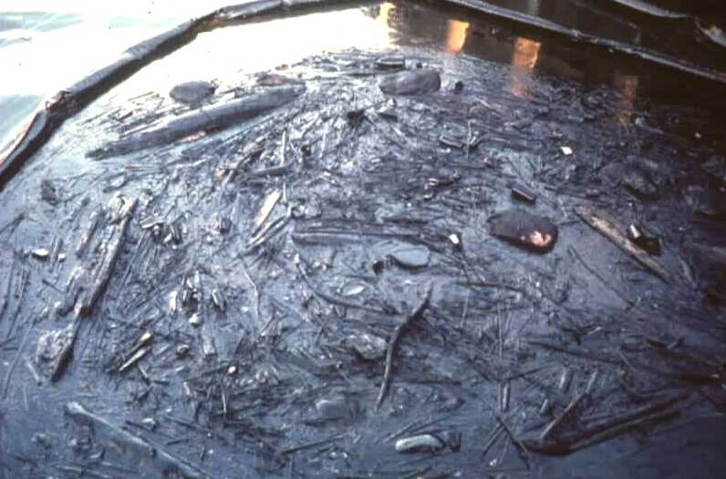
CGPRT(W) : Ensuring Clean Seas and Coasts in Western Region ……

Slide 12
Temporary and Intermediate Storage
Significant quantities of waste are generated during clean-up operations
Mainly by recovery at sea and shoreline clean-up
Less waste generated by using dispersants and in situ burning
If no storage is available, recovery operations will have to stop!
Important to think about the waste stream before beginning oil recovery operations
CGPRT(W) : Ensuring Clean Seas and Coasts in Western Region ……

Slide 13
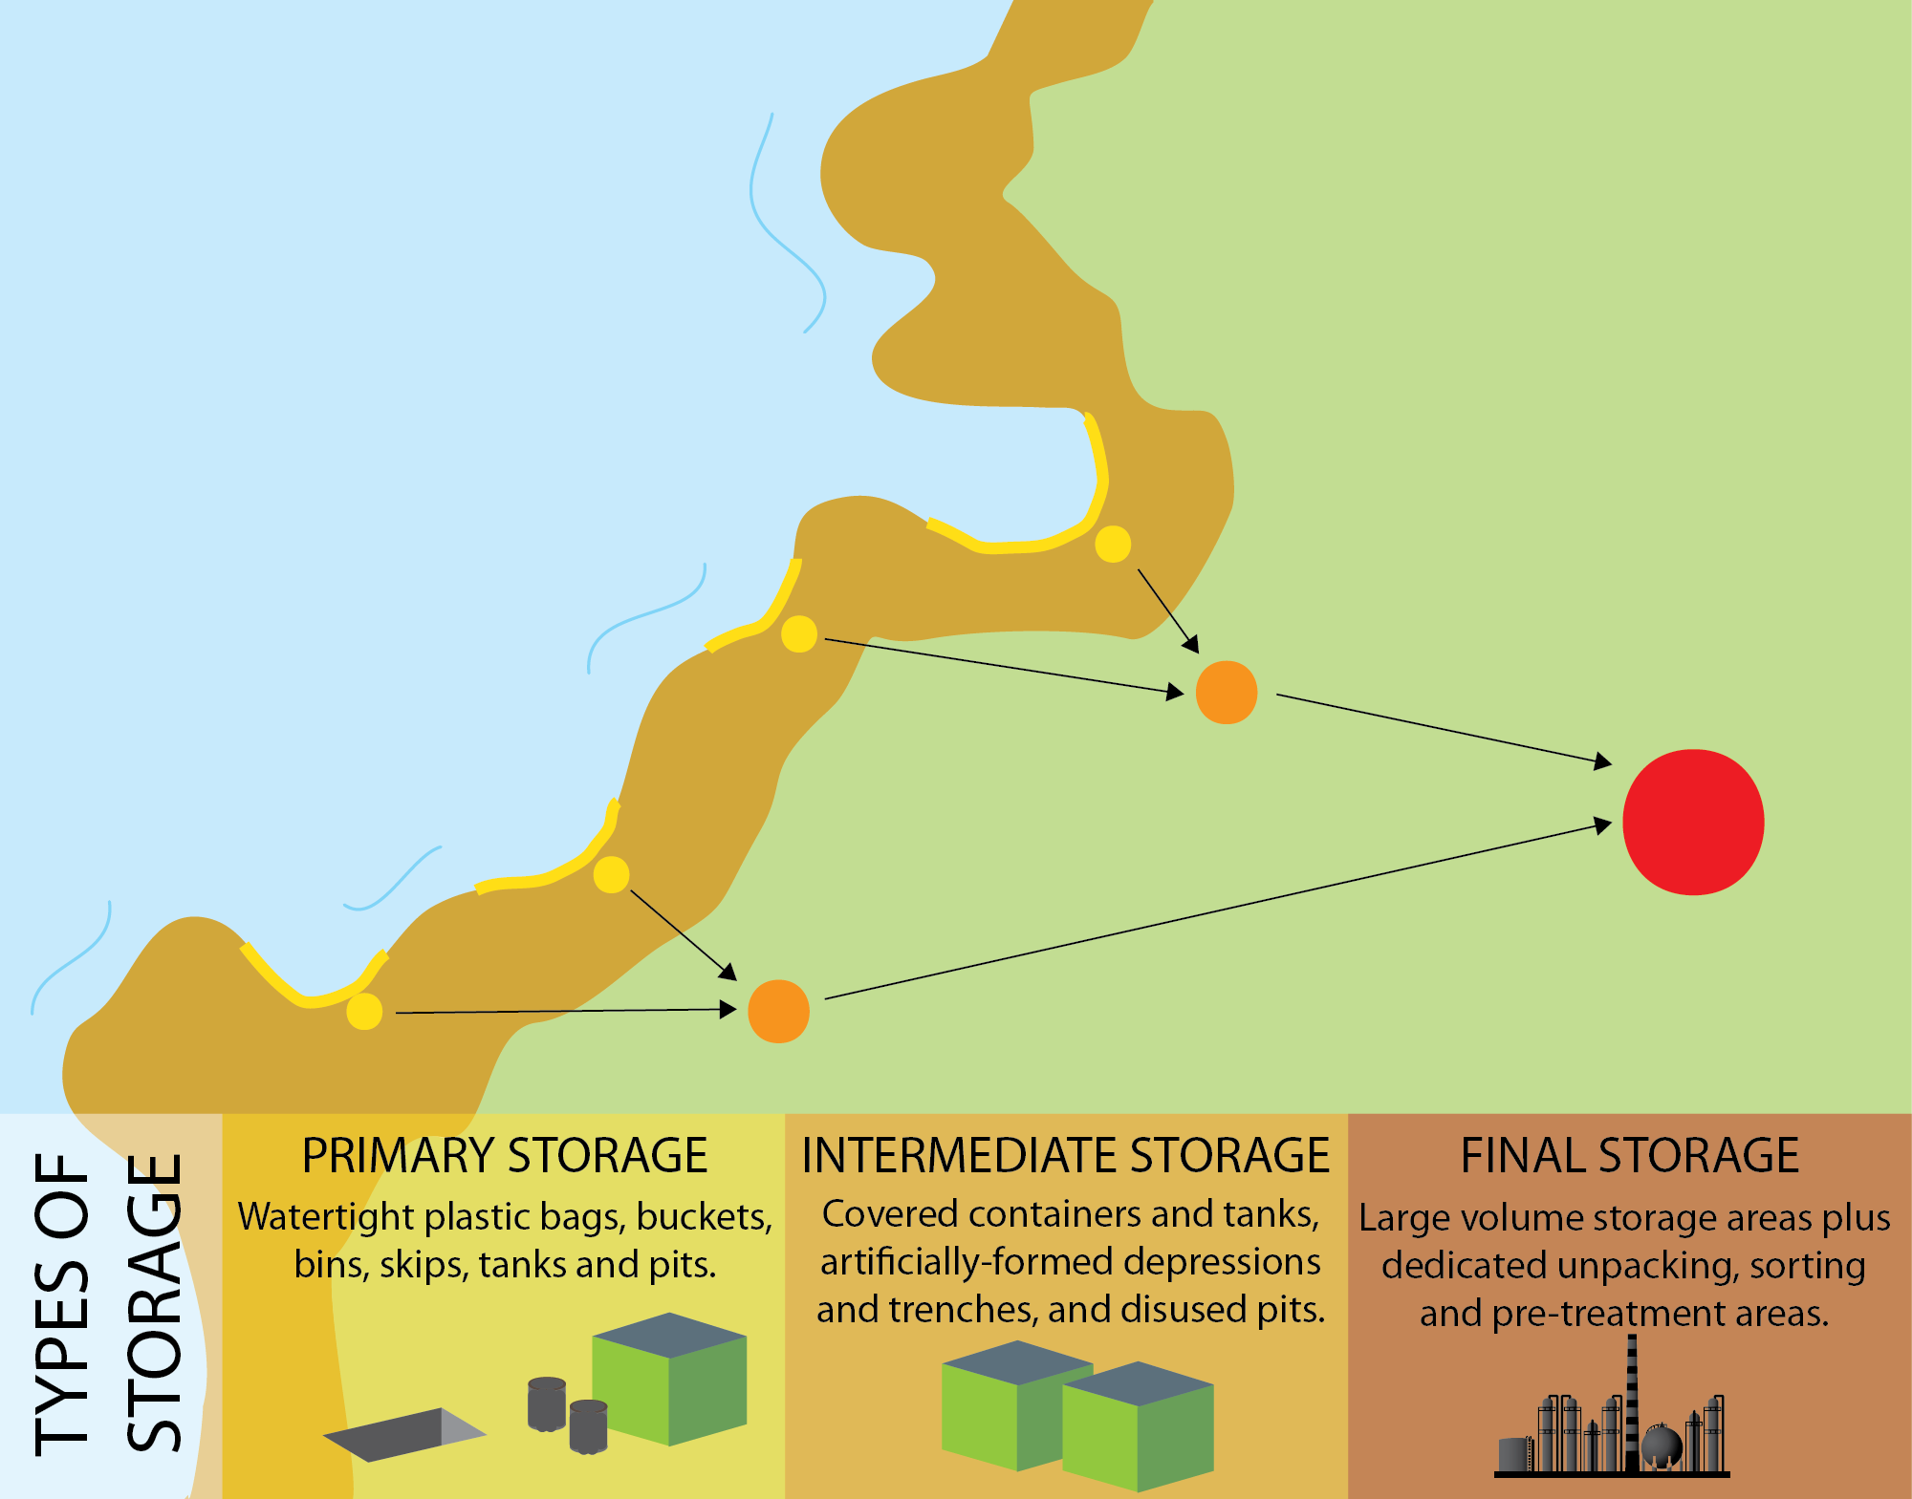
Waste Stream
Source: OSRL
CGPRT(W) : Ensuring Clean Seas and Coasts in Western Region ……

Slide 14
Temporary Storage
At sea:
Barges
Vessel tanks
Floating tanks
Onshore:
Skips
Portable tanks
Drums
Lined excavated (temporary) pits
Plastic bags
CGPRT(W) : Ensuring Clean Seas and Coasts in Western Region ……

Slide 15
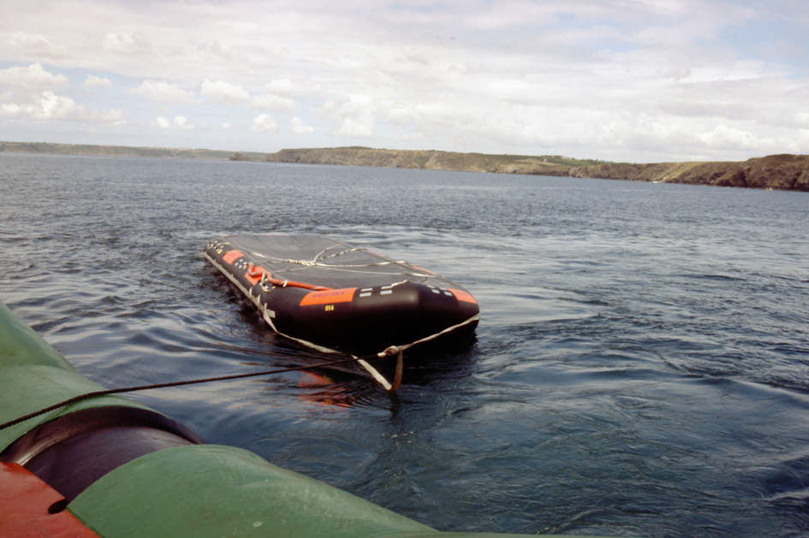
At-Sea Storage
Source: CEDRE
CGPRT(W) : Ensuring Clean Seas and Coasts in Western Region ……

Slide 16
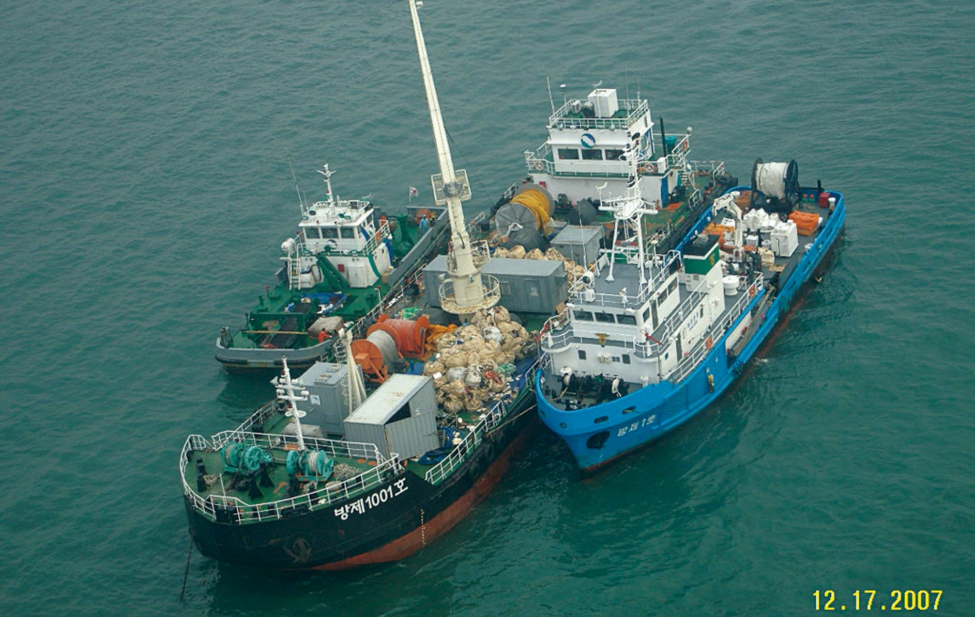
At-Sea Storage
Source: Korea Coast Guard
CGPRT(W) : Ensuring Clean Seas and Coasts in Western Region ……

Slide 17
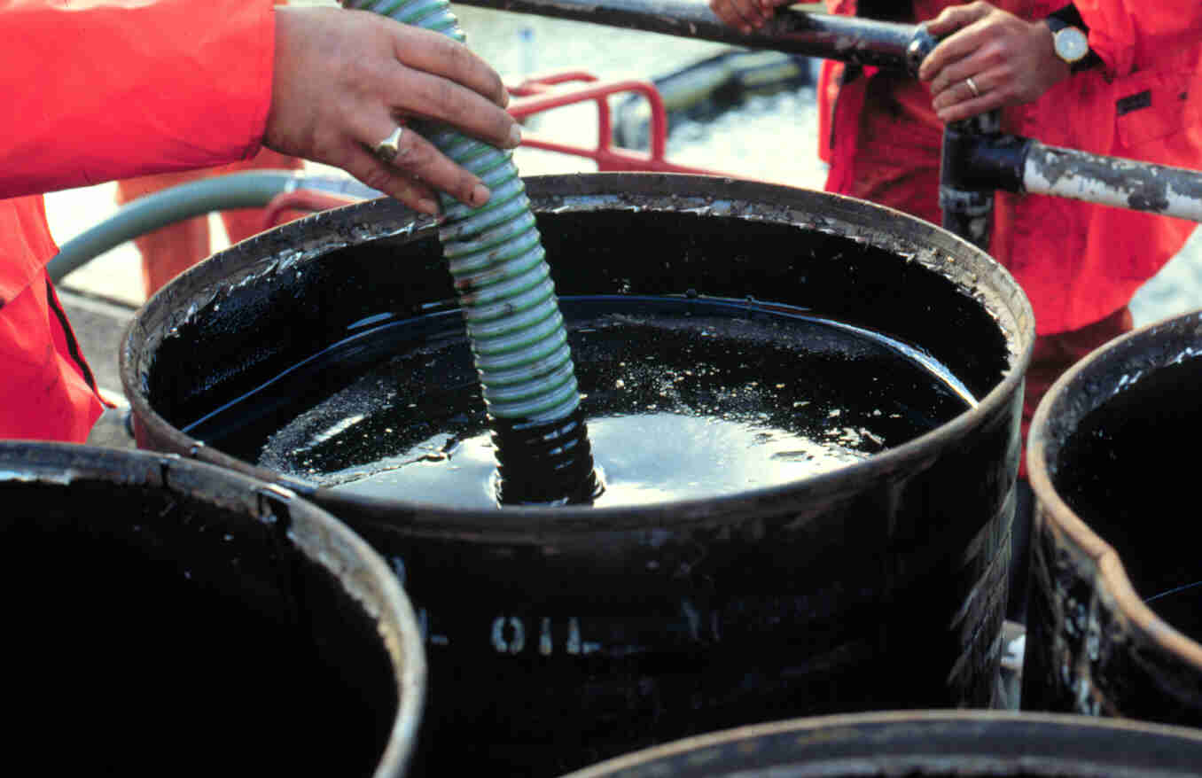
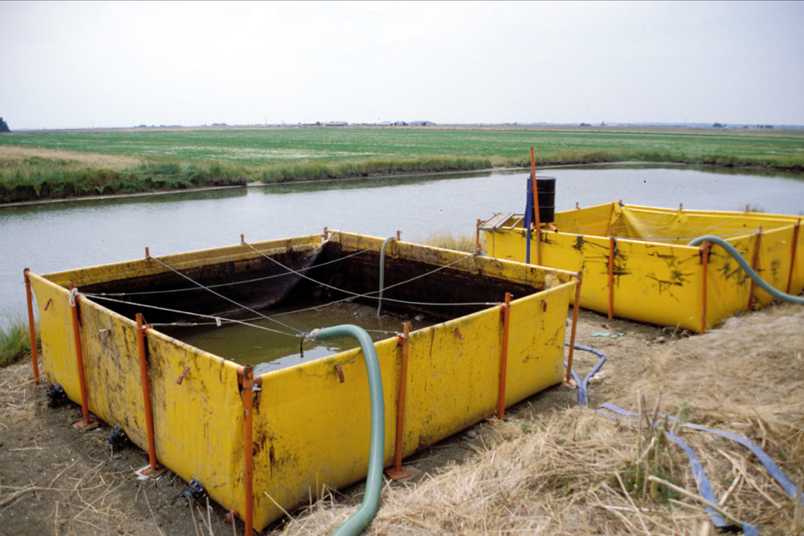
Onshore Storage
Source: OSRL
CGPRT(W) : Ensuring Clean Seas and Coasts in Western Region ……

Slide 18
Temporary Storage
Prevent secondary contamination
Ensure storage is water/oil-proof to avoid leakage
Ensure site is suitable for temporary containers
Flat with stable ground
Easy access for heavy equipment
Close to recovery sites
Install liner under temporary containers
Keep absorbent material nearby in case of a small spill
Ensure all vehicles used for waste transportation are decontaminated before leaving response sites
CGPRT(W) : Ensuring Clean Seas and Coasts in Western Region ……

Slide 19
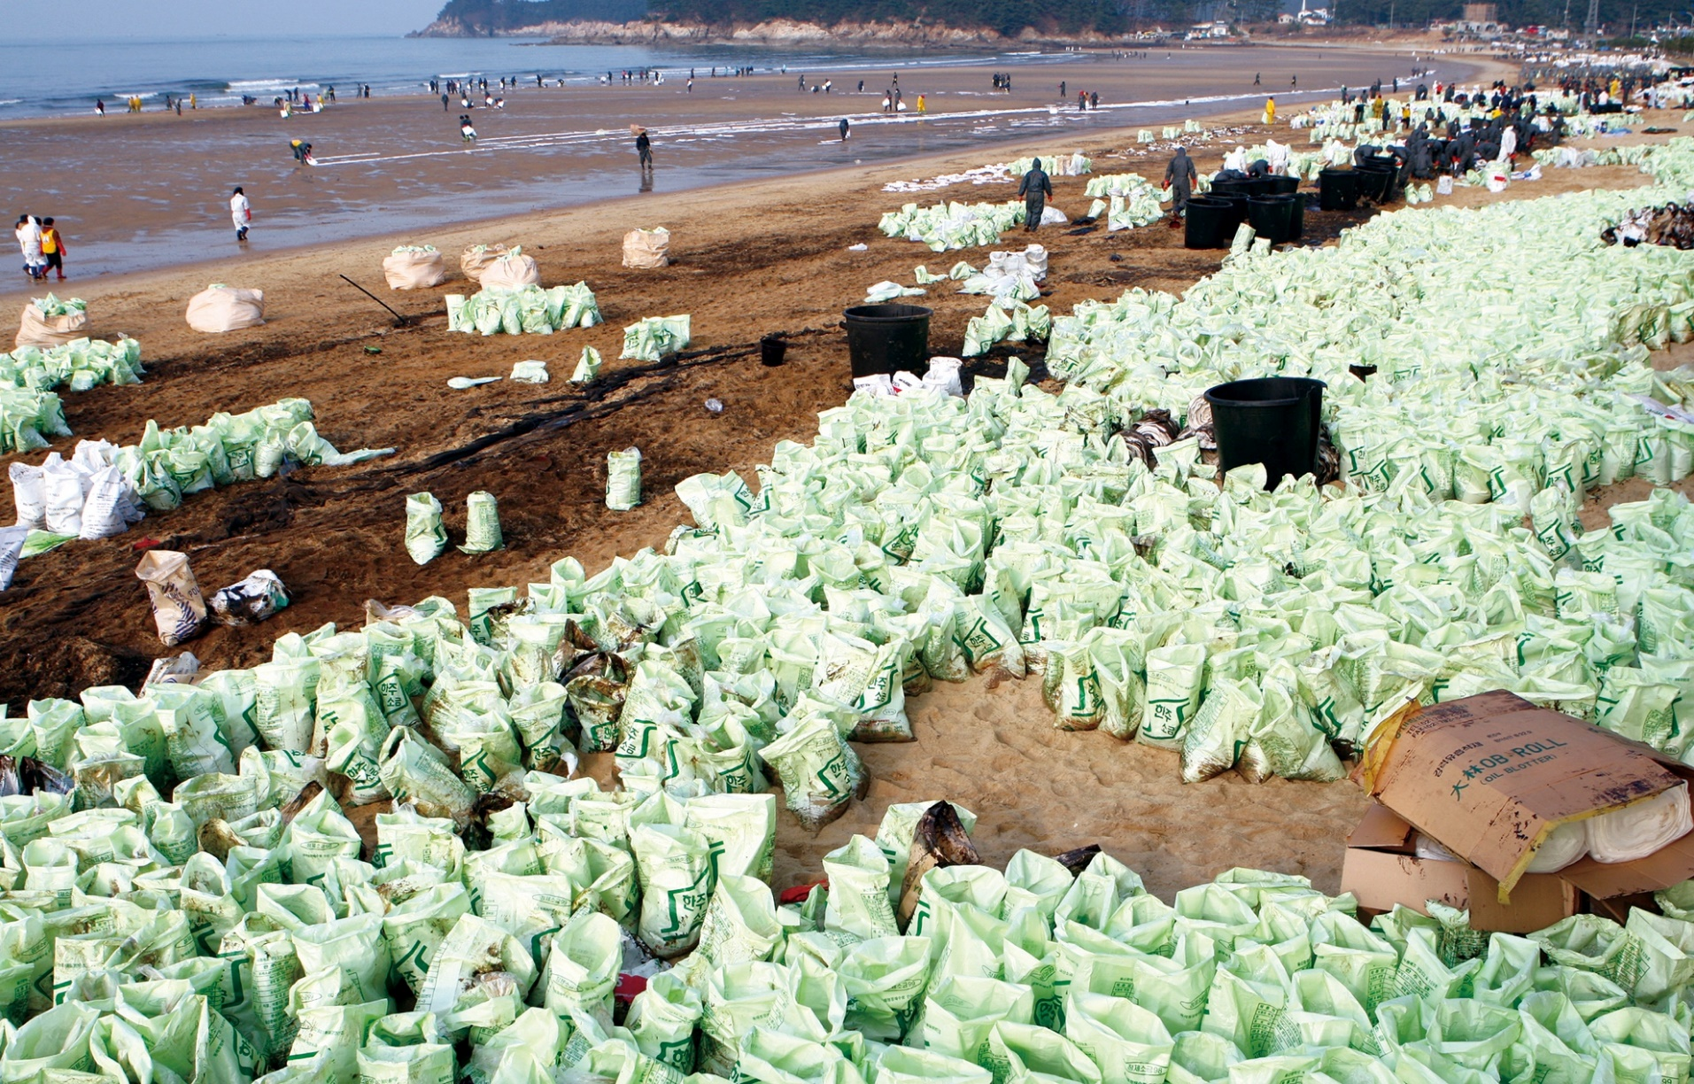
Temporary Storage
Source: Korea Coast Guard
CGPRT(W) : Ensuring Clean Seas and Coasts in Western Region ……

Slide 20
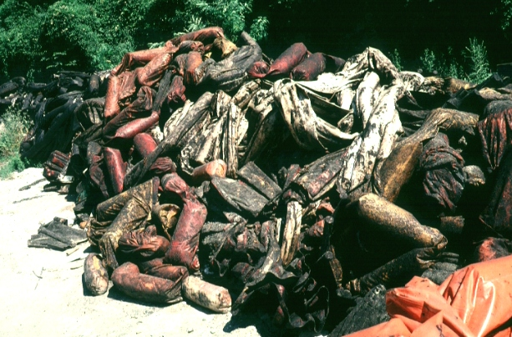
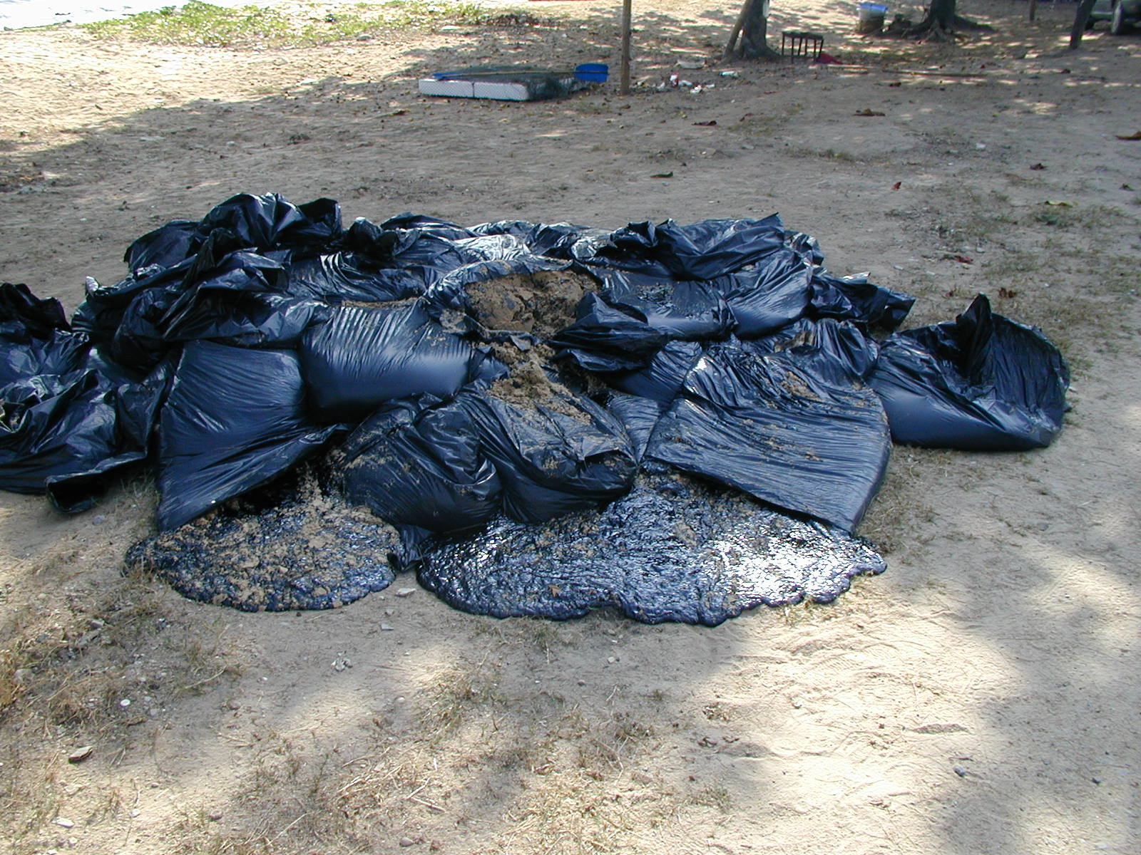
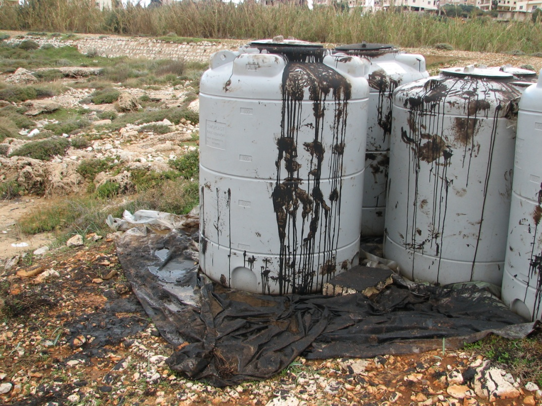
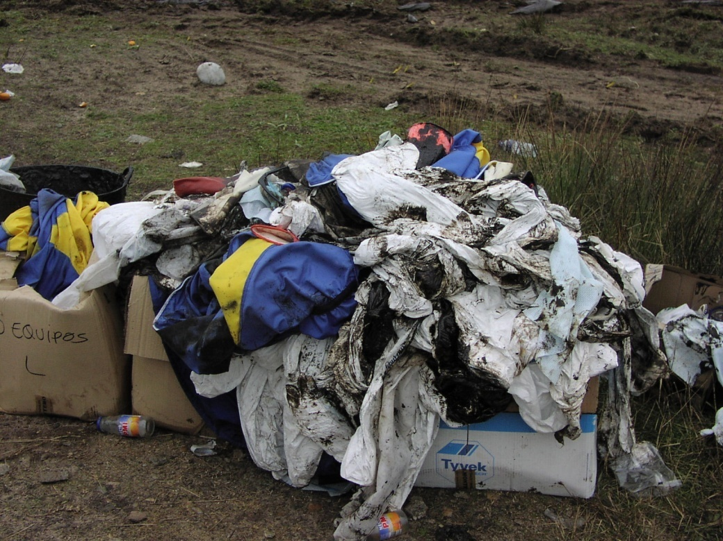
CGPRT(W) : Ensuring Clean Seas and Coasts in Western Region ……

Slide 21
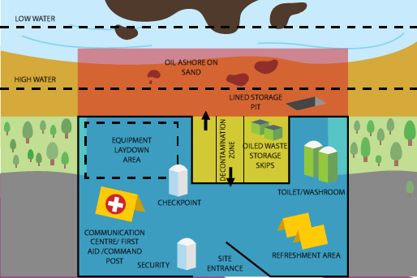
Prevent Secondary Contamination
Hot Zone
Dirty/work area: all oil stays in this zone
Warm Zone
Clean down area: Controlled entrance/exits with decontamination
Cold Zone
Waste removal vehicles can enter to remove collected waste from temporary storage sites
Source: OSRL
CGPRT(W) : Ensuring Clean Seas and Coasts in Western Region ……

Slide 22
Waste must be Separated!
By waste type
Oil
Solids (debris)
Liquids
PPE
others
Ensure training and monitoring of working crews
Ensure appropriate containers are in place for all waste types at recovery sites
CGPRT(W) : Ensuring Clean Seas and Coasts in Western Region ……

Slide 23
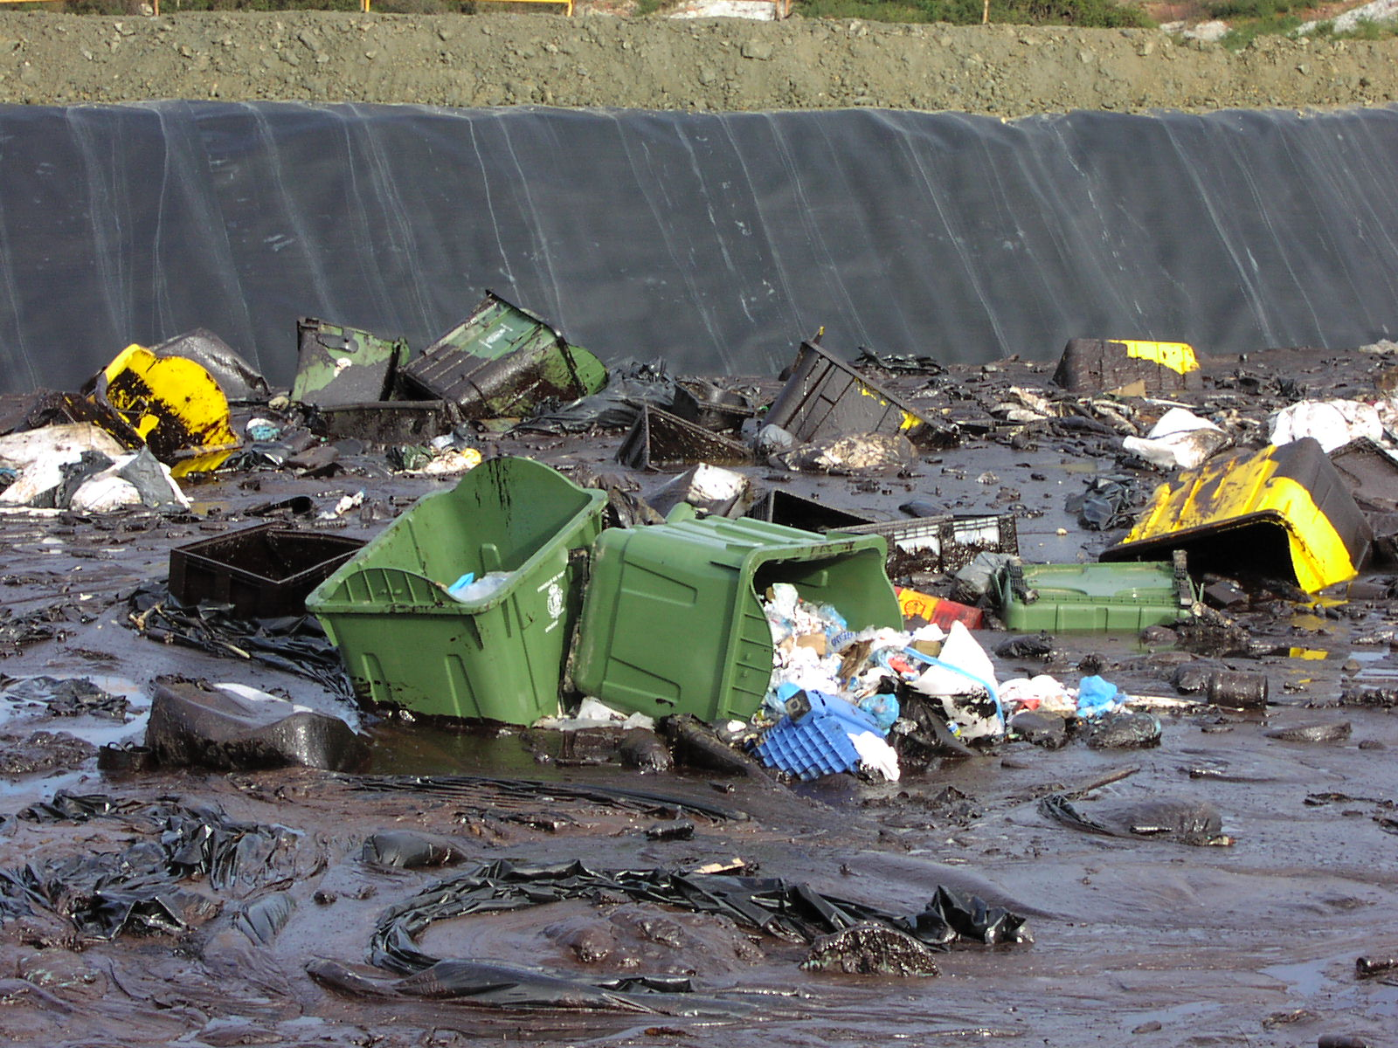
Waste must be Separated!
Source: OSRL
Source: ITOPF
CGPRT(W) : Ensuring Clean Seas and Coasts in Western Region ……

Slide 24
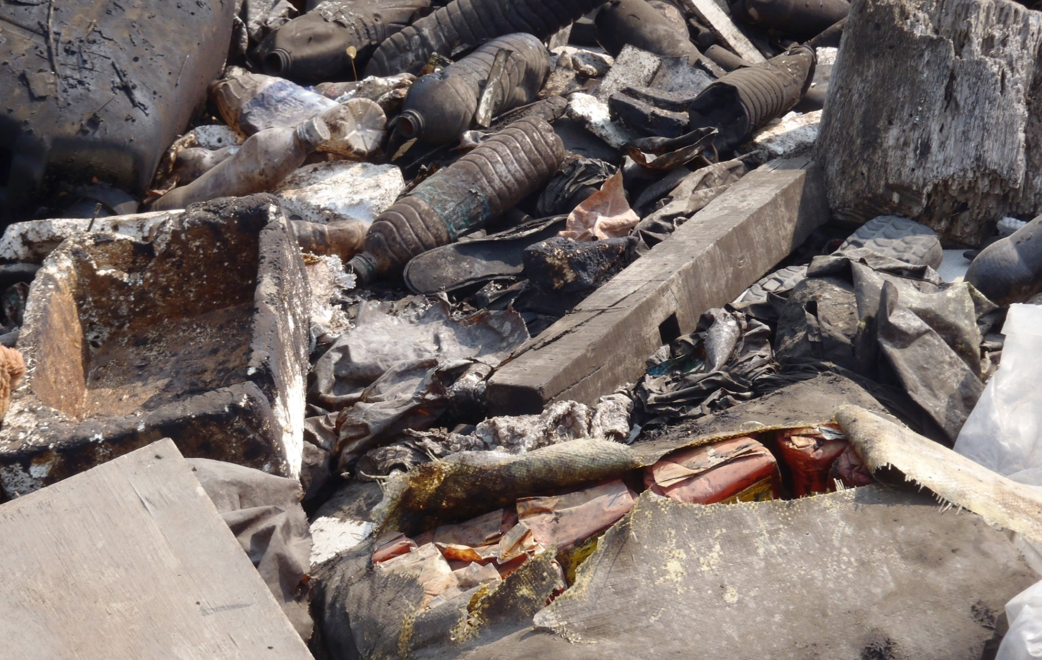
Oiled Debris
Source: OSRL
CGPRT(W) : Ensuring Clean Seas and Coasts in Western Region ……

Slide 25
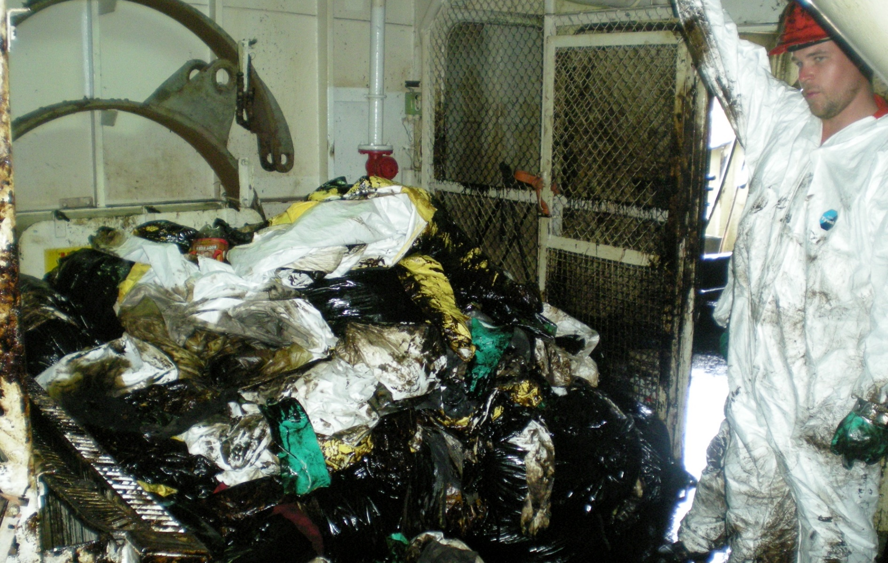
Oiled PPE
Source: OSRL
CGPRT(W) : Ensuring Clean Seas and Coasts in Western Region ……

Slide 26
Transportation
Waste in temporary storage must be transported for final disposal.
These can be transported by various means:
Trucks
Loaders
Boats
Helicopters.
Containers must be adapted for transport
Resistance
Weight.
CGPRT(W) : Ensuring Clean Seas and Coasts in Western Region ……

Slide 27
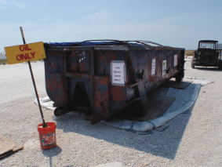
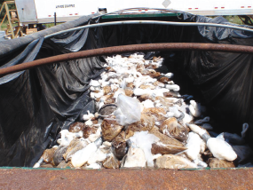
Think about Transfers!
Source: OSRL
CGPRT(W) : Ensuring Clean Seas and Coasts in Western Region ……

Slide 28
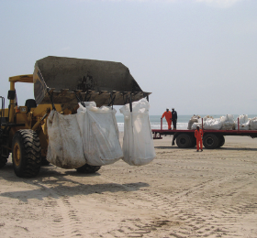
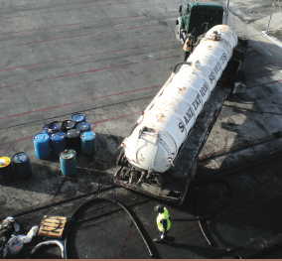
Waste Transportation
Source: OSRL
CGPRT(W) : Ensuring Clean Seas and Coasts in Western Region ……

Slide 29
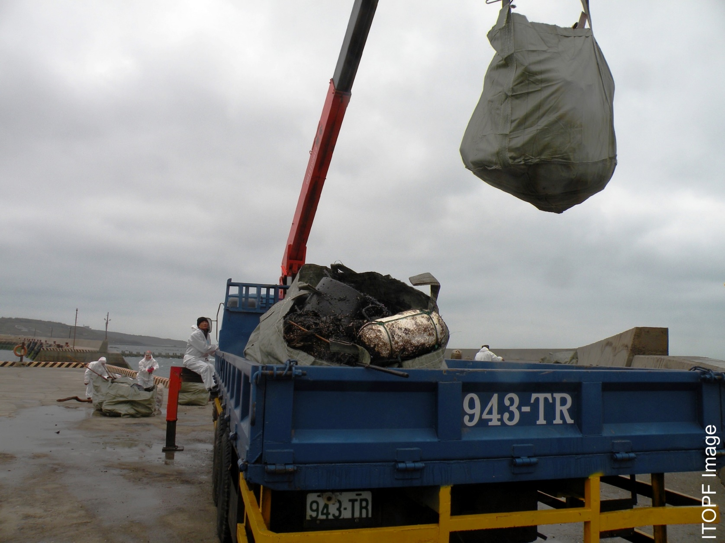
Waste Transportation
Source: ITOPF
CGPRT(W) : Ensuring Clean Seas and Coasts in Western Region ……

Slide 30
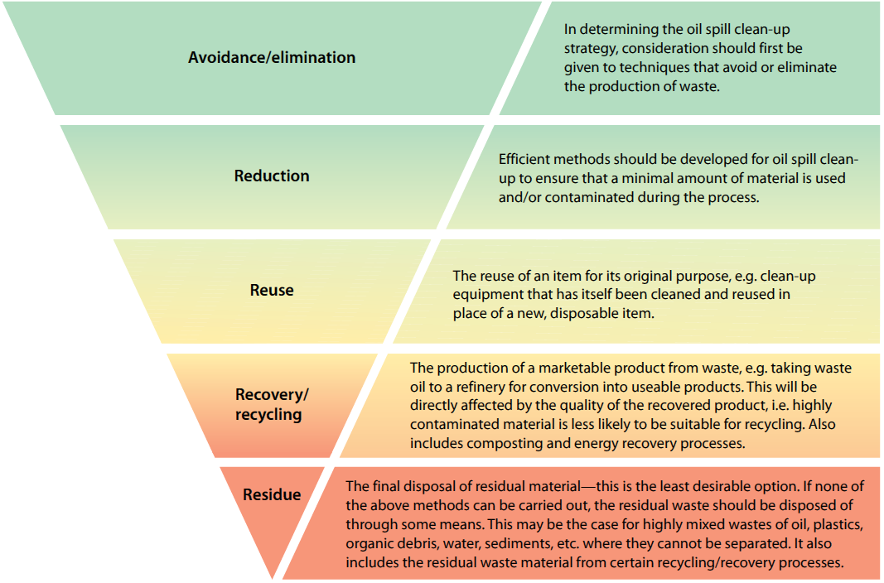
Waste Hierarchy
CGPRT(W) : Ensuring Clean Seas and Coasts in Western Region ……
Source: IPIECA

Slide 31
Final disposal
Reuse (after treatment)
Direct disposal - landfill
Stabilization - quick lime, road construction
Incineration
Land farming and composting
CGPRT(W) : Ensuring Clean Seas and Coasts in Western Region ……

Slide 32
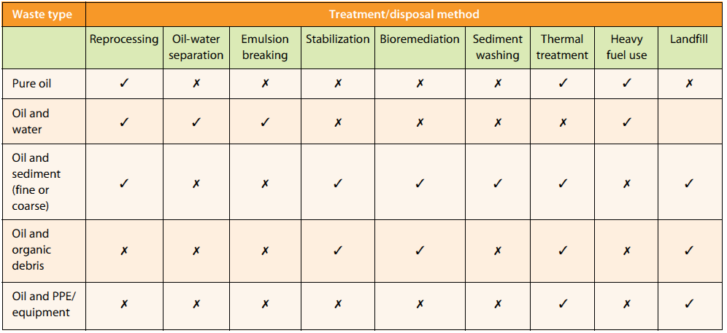
Treatment and Disposal Methods
Source: IPIECA
CGPRT(W) : Ensuring Clean Seas and Coasts in Western Region ……

Slide 33
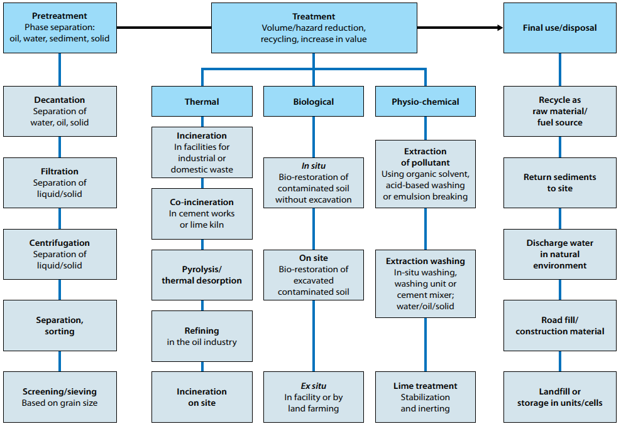
Summary of Options
Source: IPIECA
CGPRT(W) : Ensuring Clean Seas and Coasts in Western Region ……

Slide 34
Conclusion
Waste management can affect response effectiveness
Minimize – segregate
Think about the waste stream
Storage
Transfer
Transport
Field personnel must be aware of good practice for waste management
CGPRT(W) : Ensuring Clean Seas and Coasts in Western Region ……

Slide 35
Any questions?
CGPRT(W) : Ensuring Clean Seas and Coasts in Western Region ……

